Slide 1


Slide 2


Slide 3
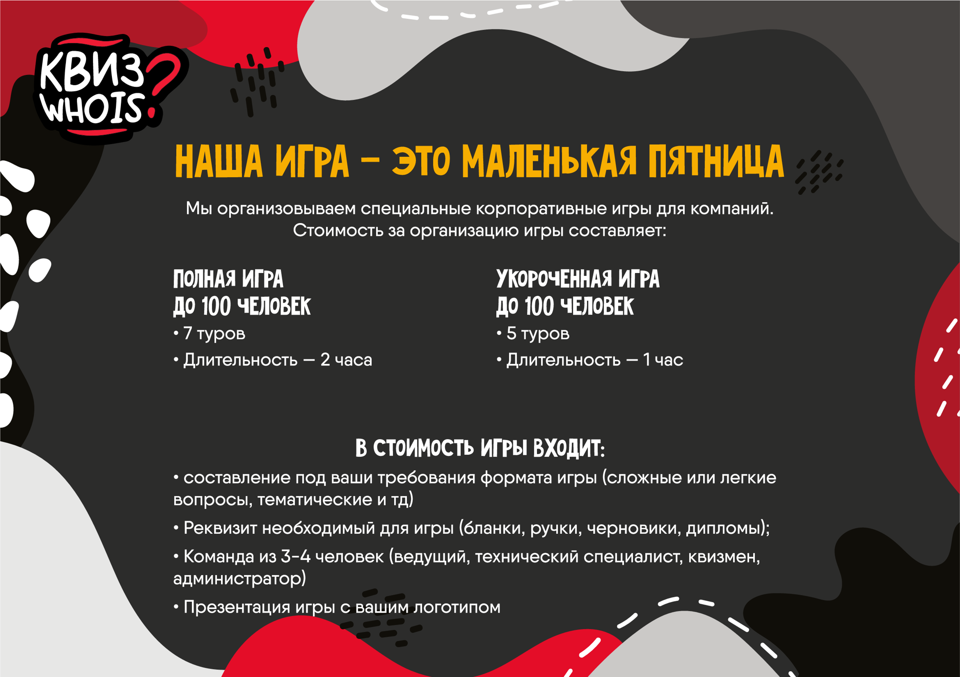
45 000
40 000

Slide 4
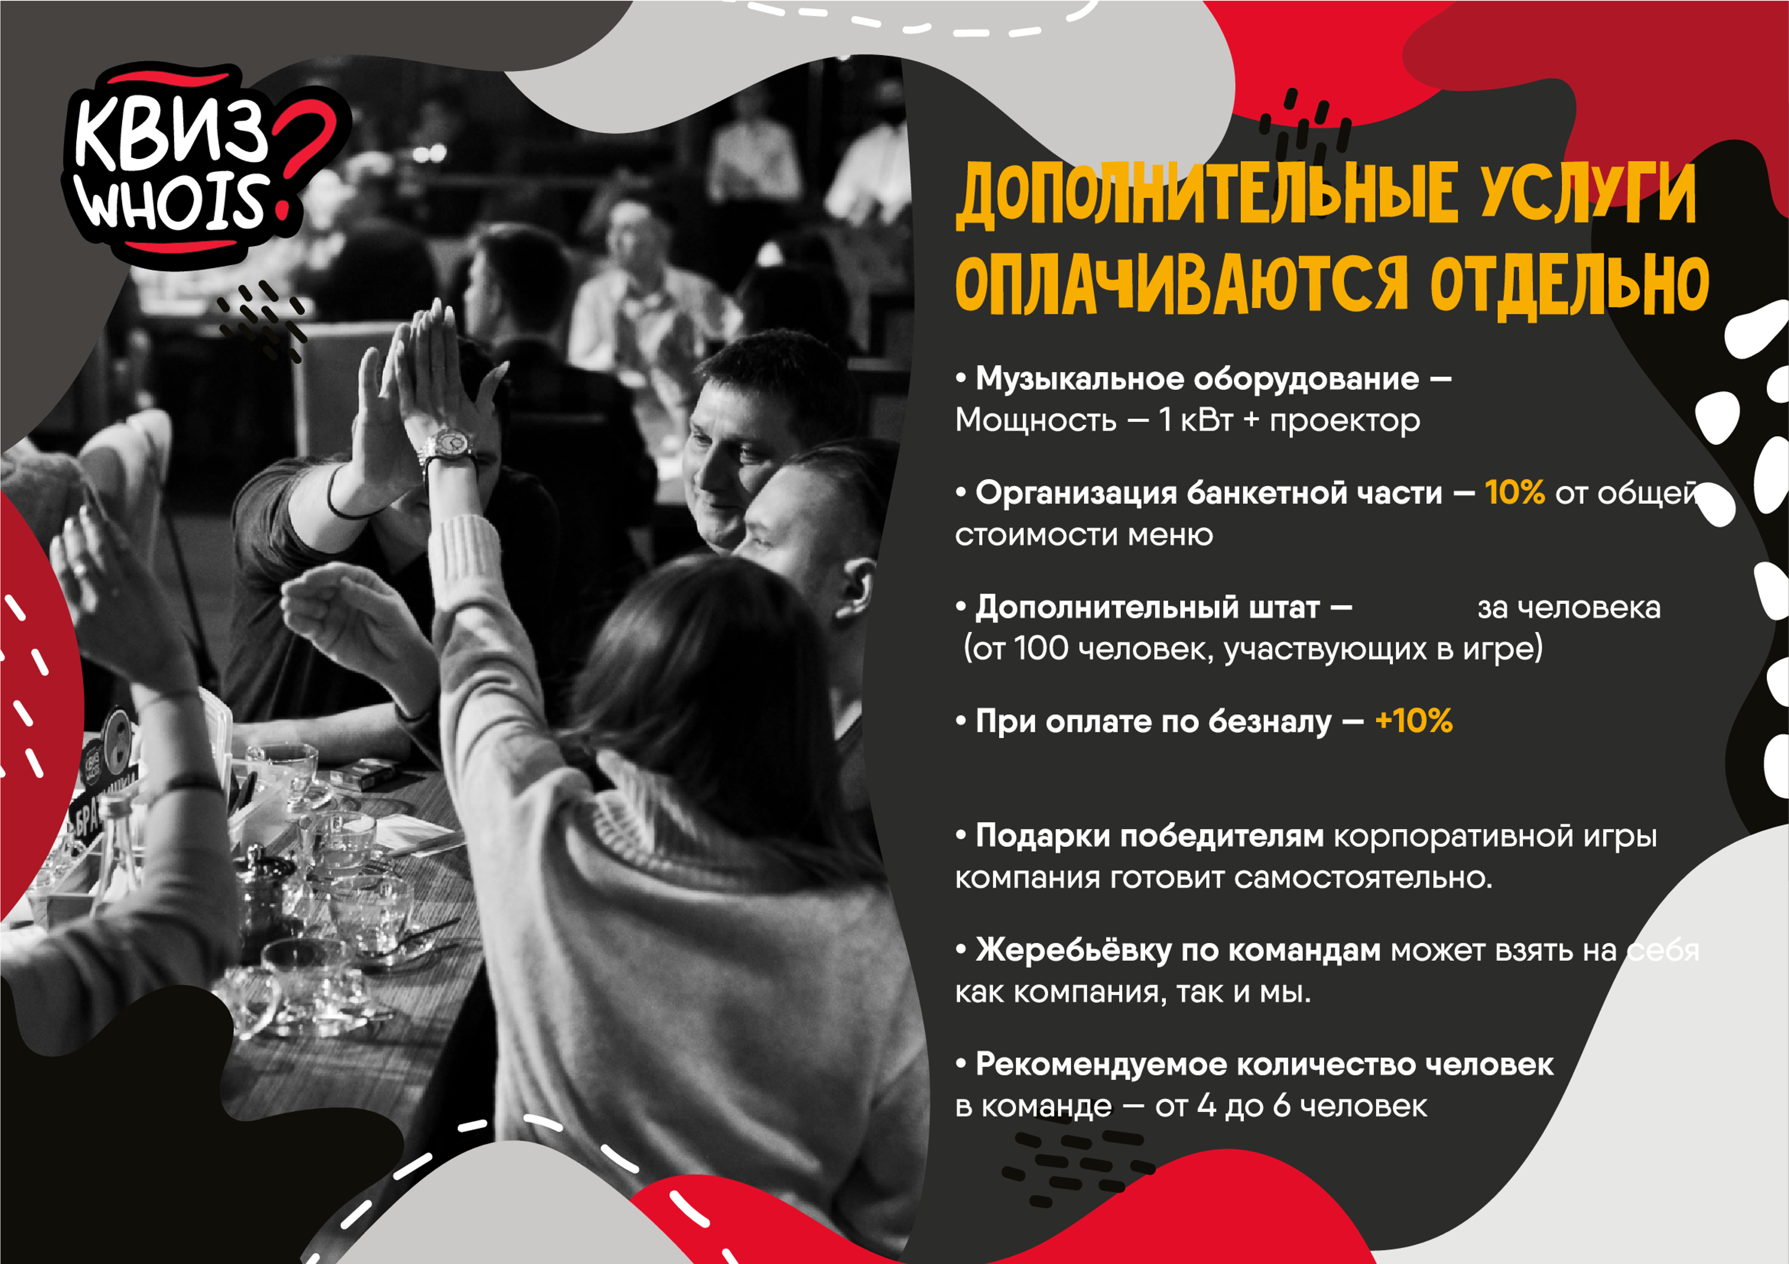
7000 ₽
1500 ₽

Slide 5


Slide 6
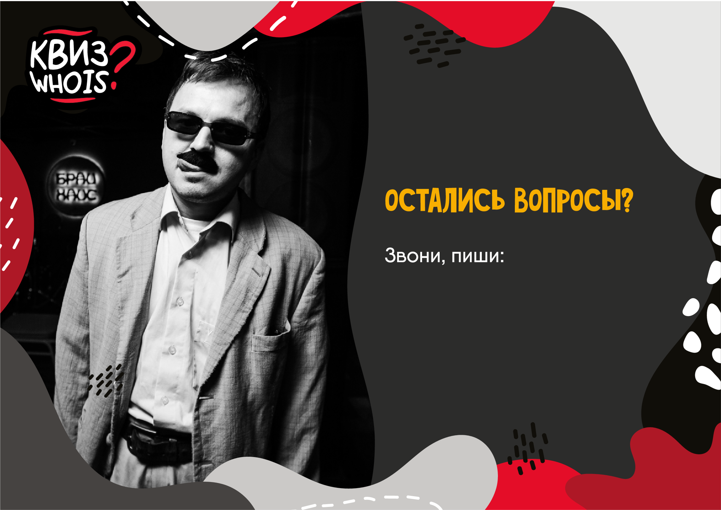
+7 996 216 64 80
Mostyura1991@gmail.com

